Slide 1
Employee salary prediction
CAPSTONE PROJECT
Presented By:
Name: Amrutha Lakshmi Vennapusa
College: Madanapalli Institution Of Technology
Dept: Computer Science and Engineering

Slide 2
OUTLINE
Problem Statement
System Development Approach
Algorithm & Deployment (Step by Step Procedure)
Result
Conclusion
Future Scope
References

Slide 3
Problem Statement
This project aims to develop a machine learning-based system that can accurately predict the salary category of an employee using historical data. By analyzing key attributes through automated learning algorithms, the system will assist organizations in making data-driven, transparent, and fair compensation decisions. The goal is to improve decision-making, reduce human error, and bring consistency to the salary determination process.

Slide 4
System Approach
The Employee Salary Prediction System was developed using a machine learning . It integrates realistic data generation, advanced machine learning, and real-time deployment in a streamlined pipeline.
System Requirements
Python 3.8+, Jupyter Notebook,
Git & GitHub
gradio
Key Libraries Used
Data Handling: pandas, numpy,
ML Models: scikit-learn
Web App: gradio

Slide 5
Algorithm & Deployment
The project follows a structured ML pipeline from data creation to cloud deployment, ensuring accuracy, scalability, and real-time performance.
Algorithm :-
Importing libraries:-
Load essential Python libraries such as pandas, scikit-learn, streamlit, and Label Encoder.
2. Load the dataset:-
Read the CSV file (adult 3.csv) using pandas. Drop any rows with missing values to clean the data
3.Data preprocessing :-
Identify categorical columns and apply Label Encoder to convert them into numeric format Separate the dataset into features (X) and target (y), where salary is the target
4.Spilt the dataset:-
Use train test split to divide the data into training and testing sets (80% train, 20% test).

Slide 6
Algorithm & Deployment
5.Train the model:-
Train a Random Forest Classifier on the training data.
6.Model evaluation :-
Predict on the test set and evaluate performance using accuracy score and classification report.
7.Built a gradio app:
Design a user interface with input widgets to accept user features (age, job type, education, etc.).Use the trained model to predict salary category in real-time Display prediction results interactively using st success().
8.Run:
Run the app

Slide 7
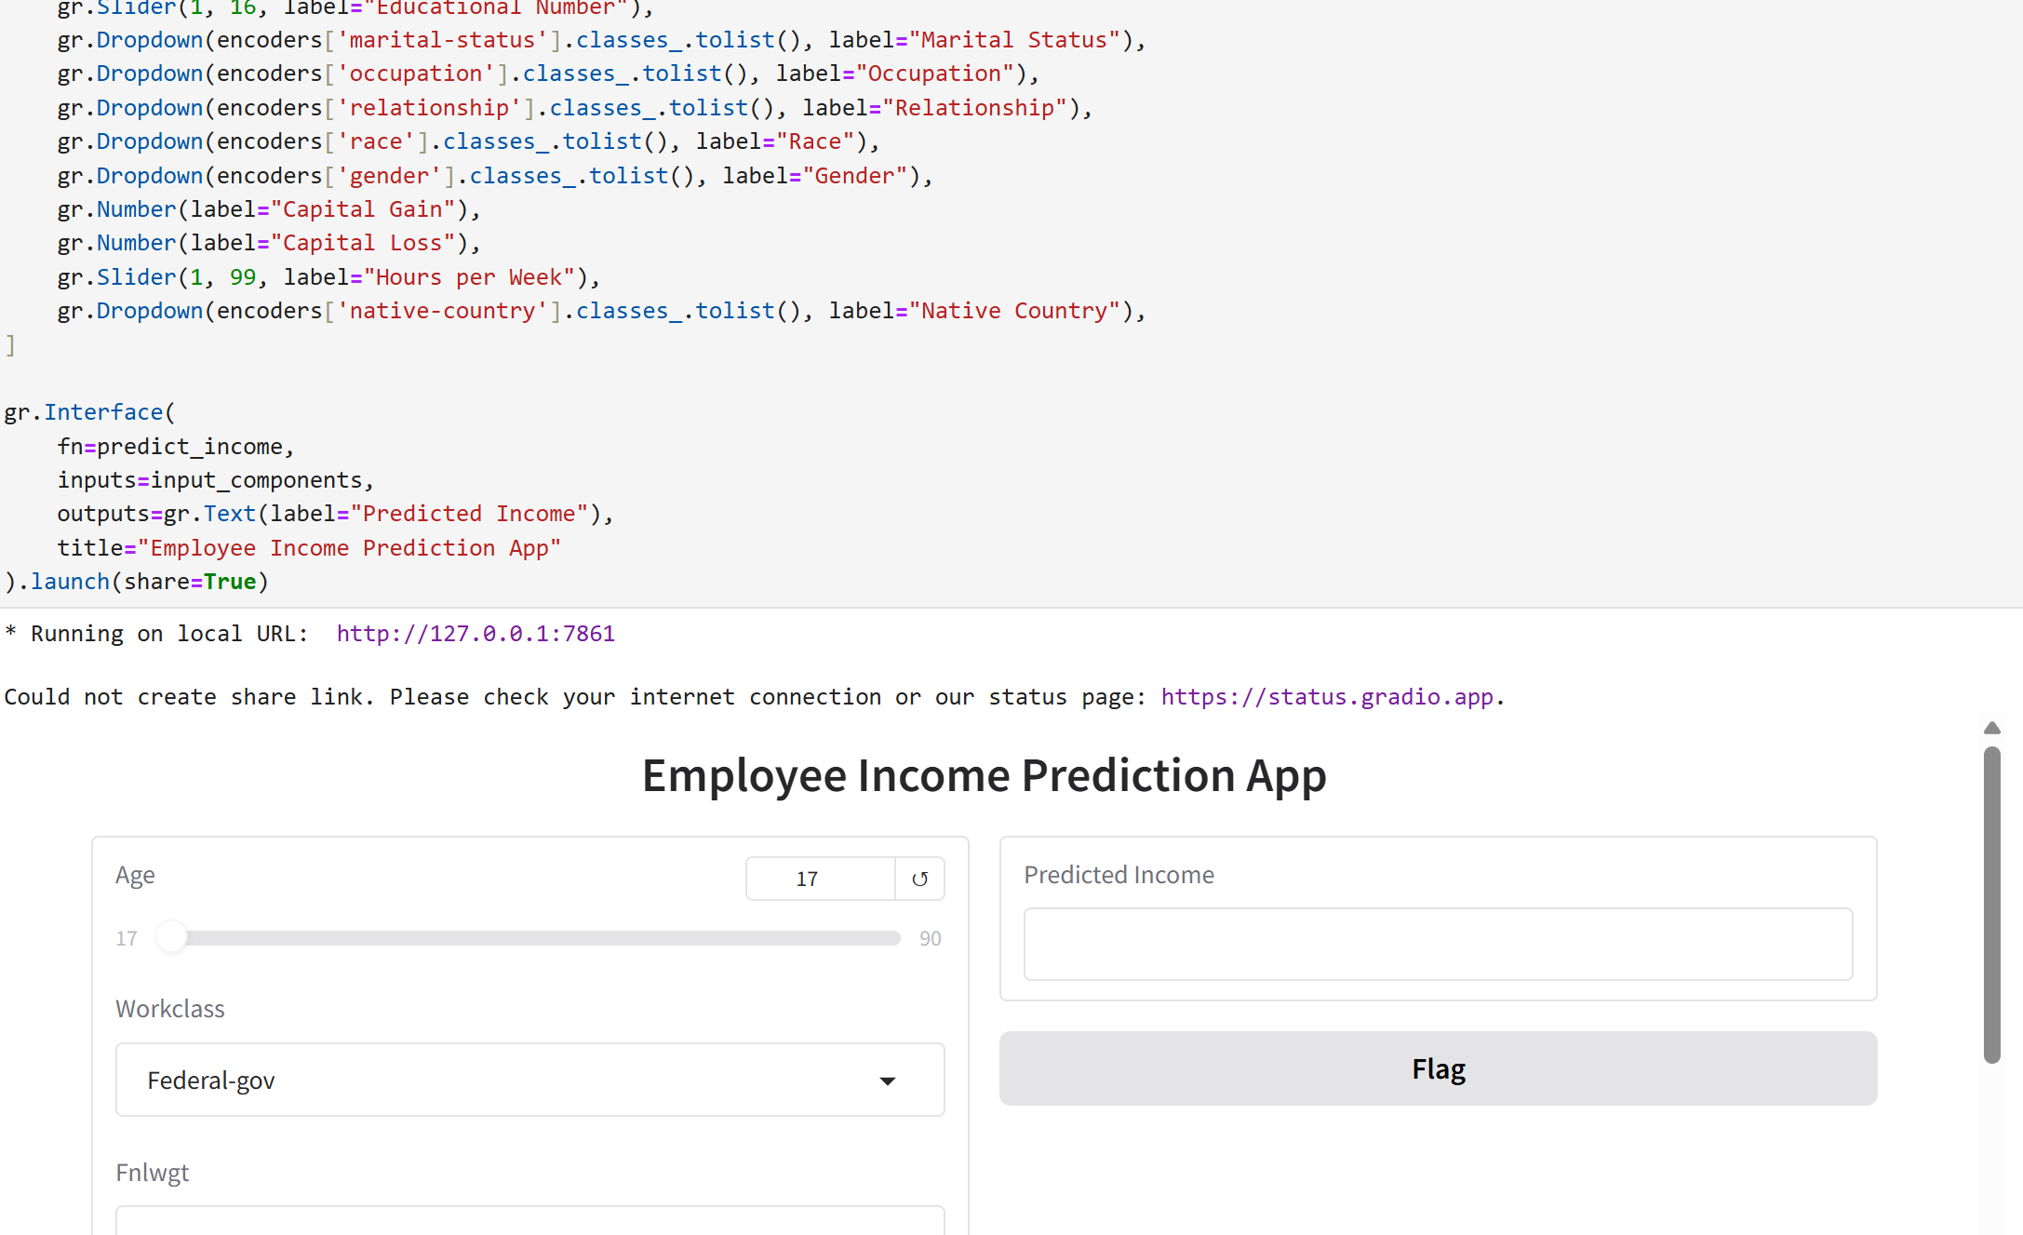
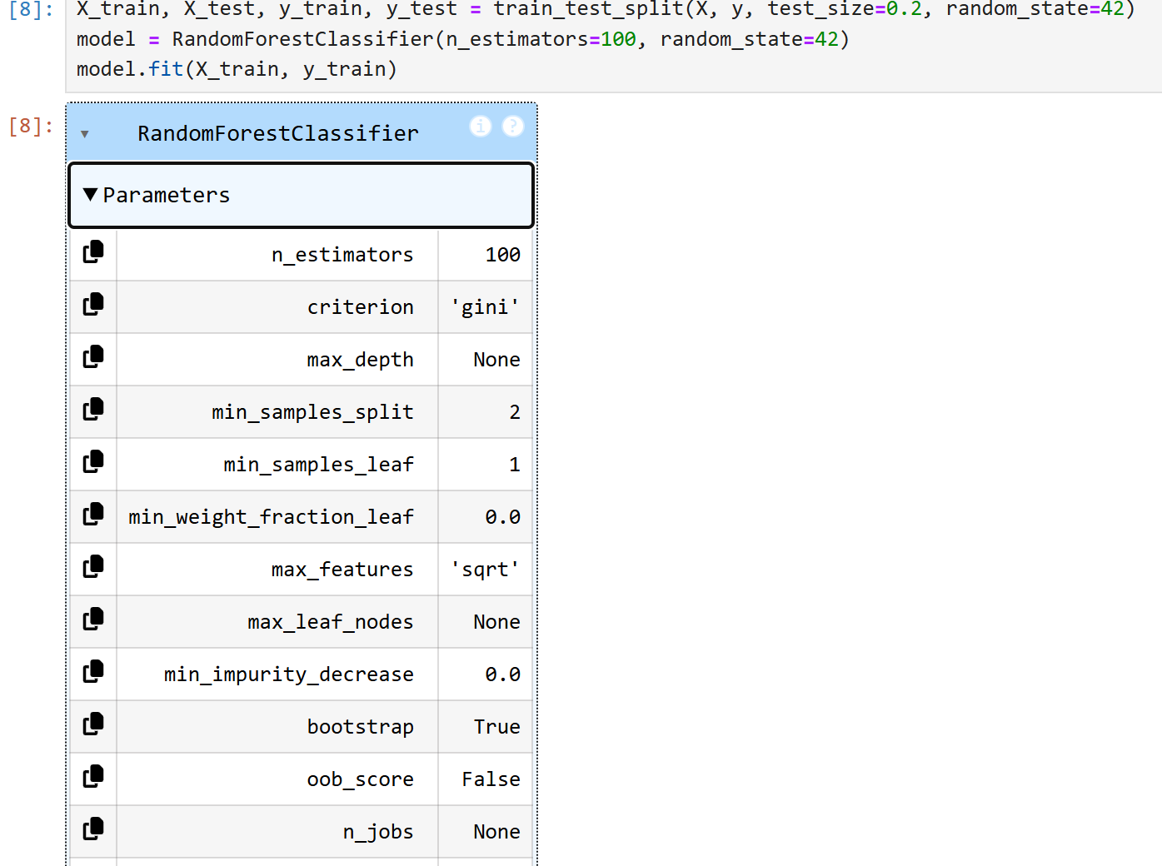
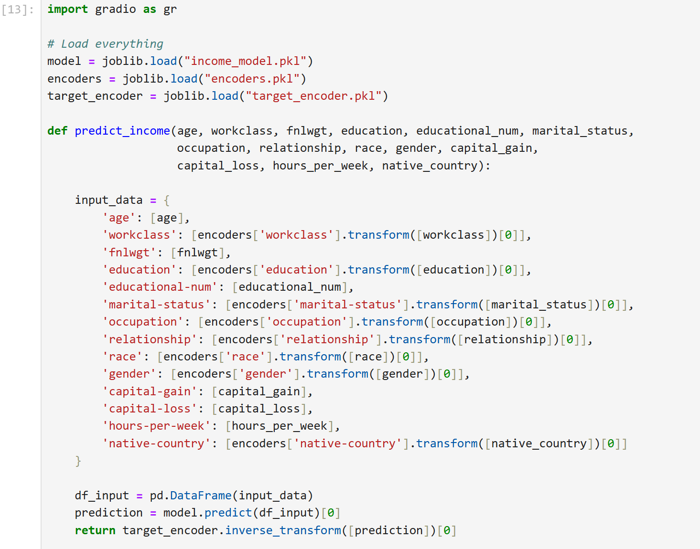
Result

Slide 8
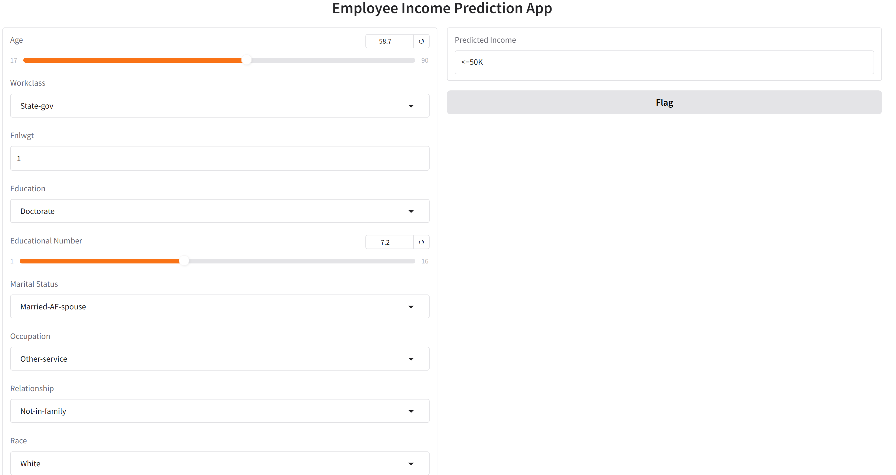
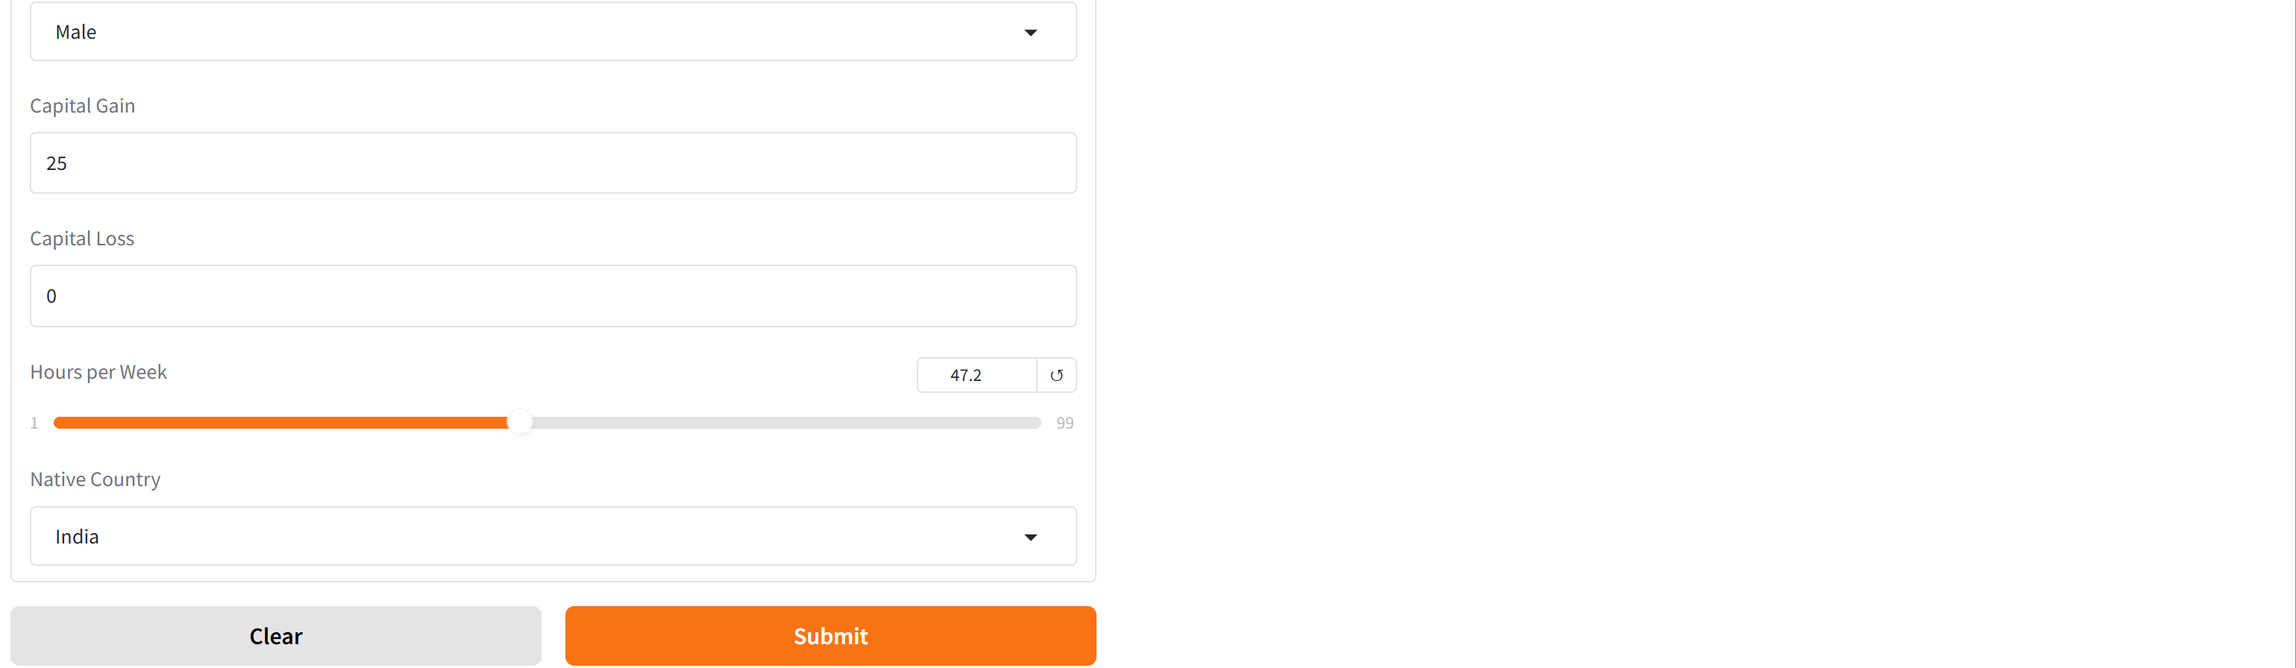
Result

Slide 9
Result
Github Repository Link: https://github.com/Amruthavennapusa072005/employee-salary-prediction.git

Slide 10
Conclusion
The Employee Salary Prediction System successfully demonstrates the end-to-end application of machine learning in solving a real-world HR analytics challenge. By simulating realistic salary data and applying advanced modeling techniques, the system achieved high prediction accuracy and practical insights into salary dynamics.

Slide 11
Future scope
Explainable AI (XAI):-
Integrate techniques such as SHAP or LIME to explain why certain predictions were made, helping build trust in the AI model
.Cloud Deployment:-
Host the app on cloud platforms like AWS, Azure, or Heroku for global access and scalability.
Salary Range Prediction:-
Extend the model to predict actual salary ranges instead of categories, making it more precise and informative for recruiters.

Slide 12
References
1.Git hub_link :
https://github.com/Amruthavennapusa072005/employee-salary-prediction.git
2.Gradio app link:
https://24e10d66ab16e3b5eb.gradio.live/
3.Jupyter notebook
4.Gradio app

Slide 13
THANK YOU

